Slide 1

Lecture 03: Higher-Order Functions (HOFs)
CS 61A SU26
June 24, 2026
Rebecca Dang
Join pollev.com/rebeccadang831 (or scan QR code) on your phone or laptop
We’ll begin at Berkeley time (10 minutes after), as per tradition!

Slide 2
Potpourri
Announcements
Quizzes
Gateway Building
Review: Control
5 min

Slide 3
Announcements
Sometimes I'll change/update lecture slides/code after the fact - check the website!
Lab 01, HW 01, and Hog (first project) are released!
Projects in this course:
  Checkpoint due date
  Early due date (extra credit!)

Slide 4
Quizzes
Highly recommend: Do orientation quiz ASAP if you haven't already
  If you miss it, CBTF will release remote, async quiz next week
Reserve Quiz 1 slot ASAP
  DSP accommodations: Please submit your letters AND login to PrairieTest (PT) ASAP so we can process your accommodations before you reserve your slot
  Accommodations do not apply retroactively if you already reserved
  If you already reserved, check that your accommodations were factored in on PT. It should show up on the home page where it shows your reservation time.
Quiz 1 logistics and practice quiz to be released (ideally) tomorrow

Slide 5
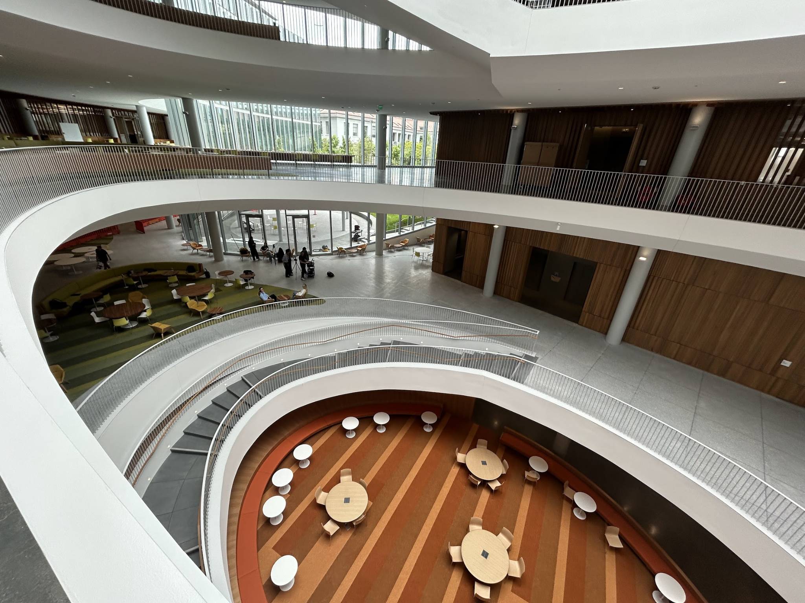

Gateway Building!

Slide 6

Gateway Building!

Slide 7
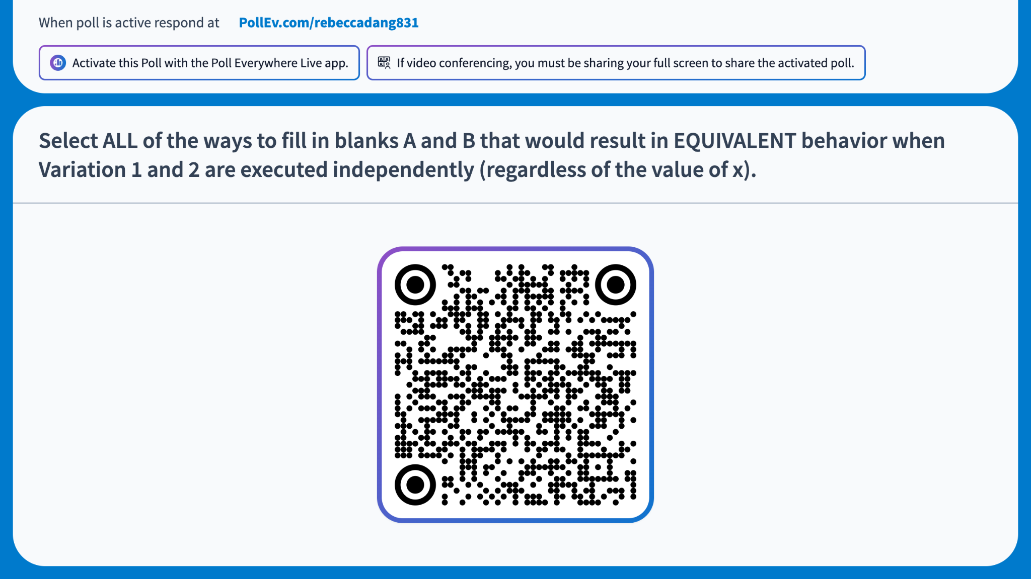
Notes:
https://PollEv.com/multiple_choice_polls/y9tFoK8AYZhqsDdicZBjn/respond
Select ALL of the ways to fill in blanks A and B that would result in EQUIVALENT behavior when Variation 1 and 2 are executed independently (regardless of the value of x).
# Variation 1
if x > 5:
return __A__
else:
return __B__
# Variation 2
def if_(cond, __A__, __B__):
if cond:
return __A__
else:
return __B__
if_(x > 5, __A__, __B__)
A: True, B: False
A: print("woo"), B: print("hoo")
A: 1 + 1, B: 2 * 2
A: 1 / 0, B: 10
Answer: (a) and (c)

Slide 8
Fibonacci
The Fibonacci sequence is defined as:
  0th Fibonacci number is 0
  1st Fibonacci number is 1
  Fibonacci number n is the sum of the previous 2 numbers
Ex: 0, 1, 1, 2, 3, 5, 8, 13, …
Wikipedia: "The Fibonacci numbers were first described in Indian mathematics as early as 200 BC in work by Pingala on enumerating possible patterns of Sanskrit poetry formed from syllables of two lengths. They are named after the Italian mathematician Leonardo of Pisa, also known as Fibonacci, who introduced the sequence to Western European mathematics in his 1202 book Liber Abaci."

Slide 9
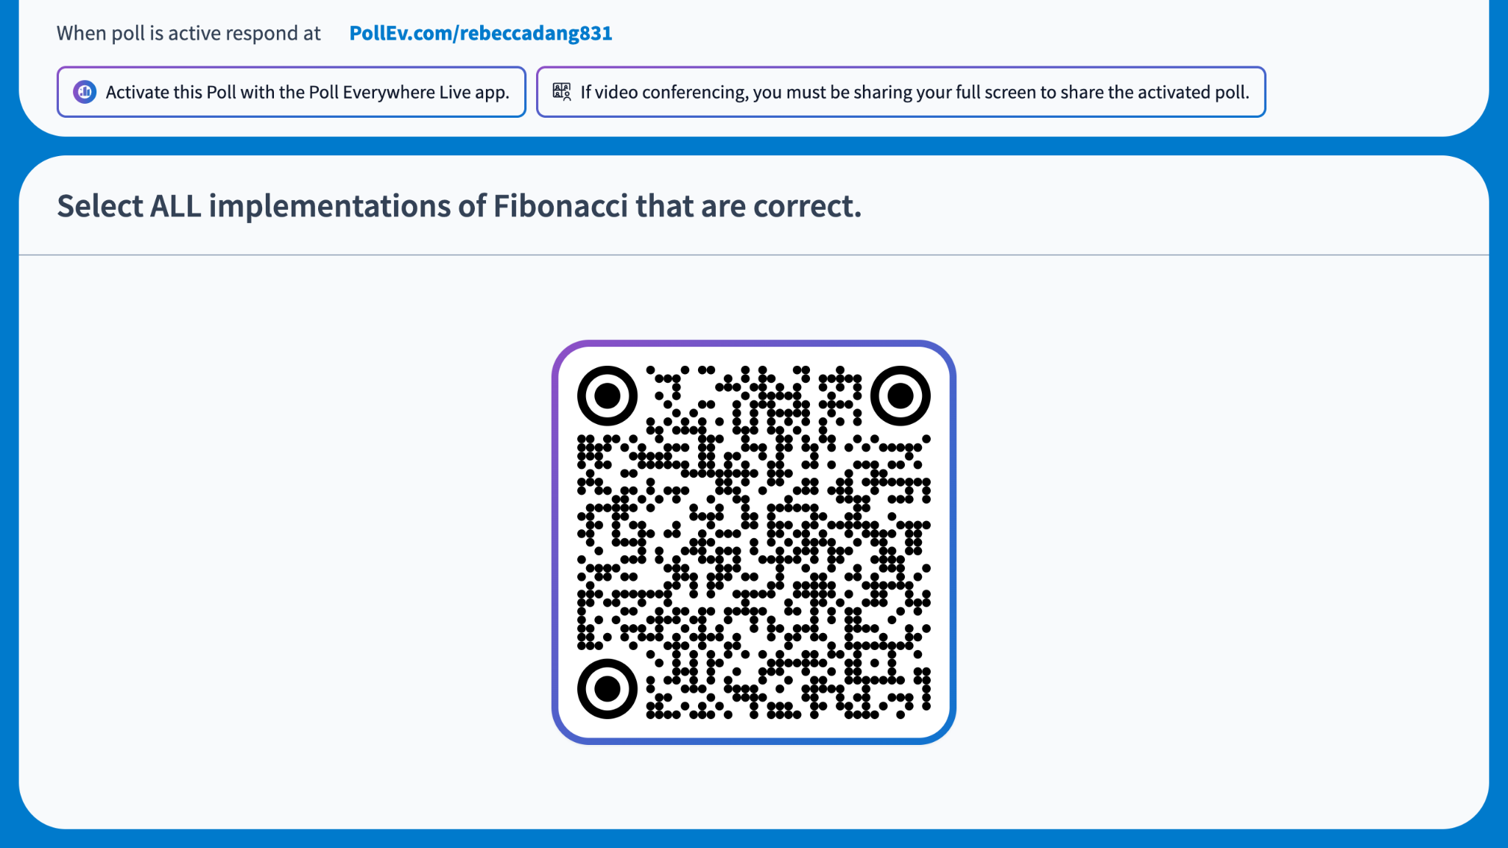
Notes:
https://PollEv.com/multiple_choice_polls/9I79Z8HGTPQl6Oj6whSlC/respond
Select ALL implementations of Fibonacci that are correct.
fib1:
def fib1(n):
curr, nxt = 0, 1
k = 0
while k < n:
curr, nxt = nxt, curr + nxt
k += 1
return curr
fib2:
def fib2(n):
prev, curr = 0, 1
k = 1
while k < n:
prev, curr = curr, prev + curr
k += 1
return curr
Answer: (a)
See doctests below to prove that fib2 is buggy for the case when n == 0:
def fib1(n):
"""Compute the n-th Fibonacci number
>>> fib1(0)
0
>>> fib1(1)
1
>>> fib1(2)
1
>>> fib1(3)
2
>>> fib1(4)
3
>>> fib1(5)
5
>>> fib1(10)
55
>>> fib1(20)
6765
"""
curr, nxt = 0, 1
k = 0
while k < n:
curr, nxt = nxt, curr + nxt
k += 1
return curr
def fib2(n):
"""
>>> fib2(0) # bug!
1
>>> fib2(1)
1
>>> fib2(2)
1
>>> fib2(3)
2
>>> fib2(4)
3
>>> fib2(5)
5
>>> fib2(10)
55
>>> fib2(20)
6765
"""
prev, curr = 0, 1
k = 1
while k < n:
prev, curr = curr, prev + curr
k += 1
return curr

Slide 10
Higher-Order Functions
Functions as data
Lambda expressions
HOFs
Functions as inputs
Functions as outputs
Lambdas: WWPD
Environments
50 min

Slide 11
Functions as data
Unlike some other programming languages, in Python, functions can be treated as both procedures and data
  Functions are "first-class" objects (more on objects later!)
Ex: In lecture 1, we "stored" min and max in variables, f and g
Demo: <function object>

Slide 12
Lambda expressions
So far, we learned to use def to define our own functions
Another way: Lambda expressions
  lambda <parameters>: <return expression>
Lambda functions are often called anonymous functions because they have no intrinsic name (unlike functions created with def)
Demo
  Lambda with 0 or more parameters
  Storing and calling a lambda function

Slide 13
HOFs
A higher-order function (HOF) is a function that takes in another function as input, returns a function as output, or both
Motivation:
  Generalization
  Avoiding repetition
    DRY: Don't Repeat Yourself
  "Factory" functions, e.g. make_discount (later slide)

Slide 14
Functions as inputs (1 of 3)
def sum_of_squares(n):
i = 1
total = 0
while i <= n:
total += i ** 2
i += 1
return total
def sum_of_cubes(n):
i = 1
total = 0
while i <= n:
total += i ** 3
i += 1
return total
Notes:
What's the difference between these 2 functions?

Slide 15
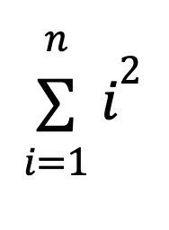
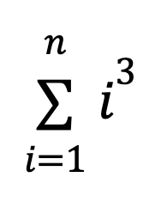
Functions as inputs (2 of 3)
def sum_of_squares(n):
i = 1
total = 0
while i <= n:
total += i ** 2
i += 1
return total
def sum_of_cubes(n):
i = 1
total = 0
while i <= n:
total += i ** 3
i += 1
return total

Slide 16
Functions as inputs (3 of 3)
def summation(n, term):
i = 1
total = 0
while i <= n:
total += term(i)
i += 1
return total

Slide 17
Functions as outputs (1 of 2)
def half_off(price):
return price * 0.5
def ten_percent_off(price):
return price * 0.9
def twenty_percent_off(price):
return price * 0.8
def compute_new_price(discount, price):
return discount(price)

Slide 18
Functions as outputs (2 of 2)
def make_discount(percent_off):
def discount(price):
return price * (1 - percent_off)
return discount
def compute_new_price(discount, price):
return discount(price)
>>> half_off = make_discount(0.5)
>>> compute_new_price(half_off, 20)
10.0

Slide 19
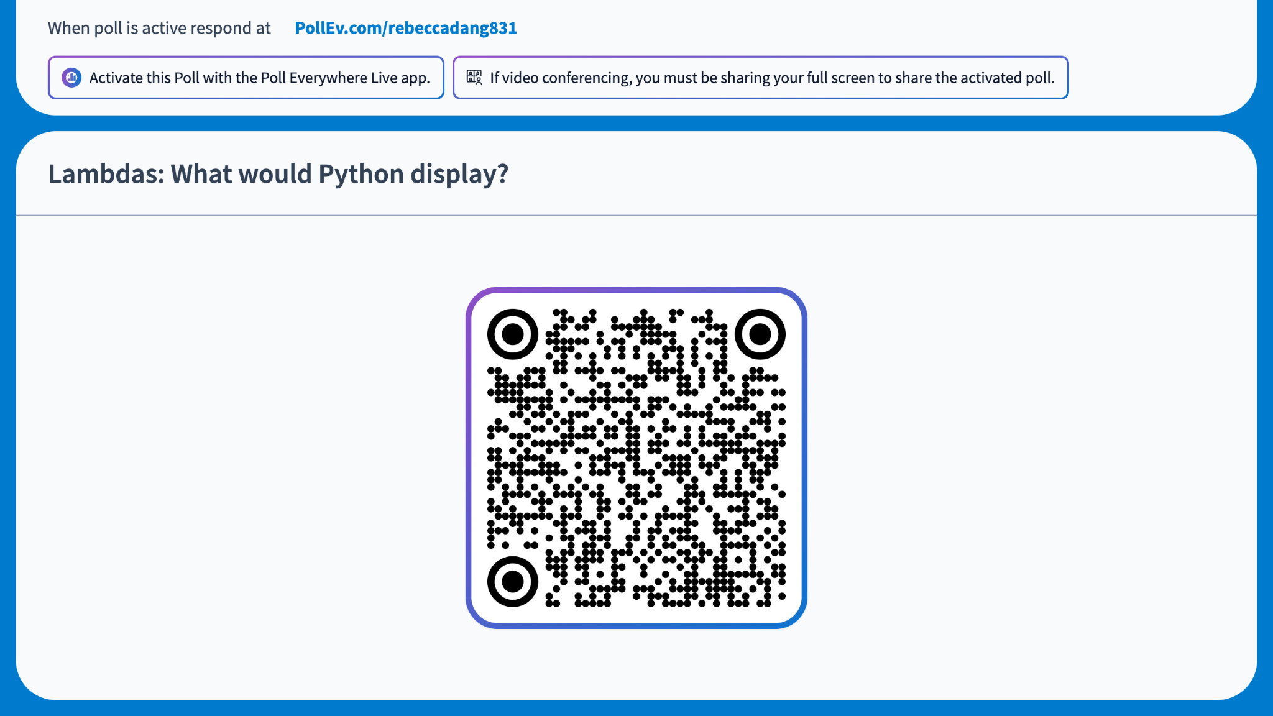
Notes:
https://PollEv.com/multiple_choice_polls/5CikE5KgDzM8vwdRxlOFA/respond
Lambdas: What would Python display?
>>> (lambda x, y: lambda z: x * y + z)(1, 2)(3)
1
2
3
5
A function object
None
It would error
Answer: (d)

Slide 20
Lambdas WWPD: What happened? (1 of 5)
(lambda x, y: lambda z: x * y + z)(1, 2)(3)
Outer function called directly
Operands of outer function (x and y)

Slide 21
Lambdas WWPD: What happened? (2 of 5)
(lambda x, y: lambda z: x * y + z)(1, 2)(3)
Return expression of outer function

Slide 22
Lambdas WWPD: What happened? (3 of 5)
(lambda x, y: lambda z: x * y + z)(1, 2)(3)
Since the inner function was returned, this entire thing evaluates to that inner function

Slide 23
Lambdas WWPD: What happened? (4 of 5)
(lambda x, y: lambda z: x * y + z)(1, 2)(3)
Return expression of inner function (has access to x and y from its parent frame)
Operand of inner function (z)

Slide 24
Lambdas WWPD: What happened? (5 of 5)
(lambda x, y: lambda z: x * y + z)(1, 2)(3)
def outer(x, y):
def inner(z):
return x * y + z
return inner
outer(1, 2)(3)
Tip: Rewrite lambda into def if you're confused on what it's doing! Or do the opposite if we ask you to write a nested lambda.

Slide 25
Environments
In a previous slide, we talked about "parent frame"
  But what's a parent? And what's a frame?
  How do we figure out what data we have access to in a program? (e.g. variable scope)
An environment is a sequence of frames
  You might also hear programmers call it a "stack" of frames, hence the term "stack trace" from Lecture 1: Exceptions, or "stack overflow" (we'll talk about that next week!)
A frame is a set of bindings between names and values
All Python programs begin in the special global frame

Slide 26
Name Lookup Rules
A function's parent frame is the frame in which the function is defined (not the frame in which it's called)
Each time we call a function, we open a new local frame
When we try to retrieve the value of a name, we first look in the current frame
  If it's not there, we recursively check if it exists in the parent frame
  If we go all the way up to the global frame and it's still not there, throw a NameError
⚠️ Caution: You can't update a variable outside your local frame (results in UnboundLocalError)

Slide 27
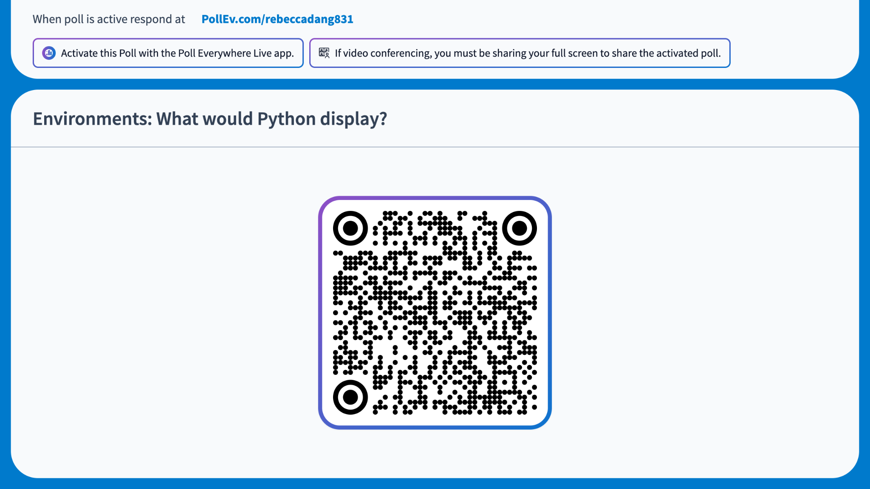
Notes:
https://PollEv.com/multiple_choice_polls/tE8ntF5YKtIHPOsXSB2uv/respond
Environments: What would Python display?
>>> x = 7
>>> y = 15
>>> def unicorn(y, x):
... x = x + z
... return y + x
...
>>> def rainbows(z):
... z = 5
...
>>> z = 10
>>> rainbows(z)
>>> unicorn(x, y)
12
22
32
42
Error, because z is not defined in unicorn
Error, because we're updating z outside its local frame in rainbow
Answer: (c)
Environment diagram: https://pythontutor.com/visualize.html#code=x%20%3D%207%0Ay%20%3D%2015%0Adef%20unicorn%28y,%20x%29%3A%0A%20%20%20%20x%20%3D%20x%20%2B%20z%0A%20%20%20%20return%20y%20%2B%20x%0A%0Adef%20rainbows%28z%29%3A%0A%20%20%20%20z%20%3D%205%0A%0Az%20%3D%2010%0Arainbows%28z%29%0Aunicorn%28x,%20y%29%0A&curInstr=0&mode=display&origin=opt-frontend.js&py=311

Slide 28
5 min break

Slide 29
HOFs Practice
Combination
Multiply Triple
20 min

Slide 30
Practice: Combination
Implement a higher-order function combination(n, initial, combiner, term) See the doctests for examples.
Download starter code 03.py from the course website under Lecture 3
Run doctests with python3 -m doctest 03.py
5 min: Try implementing it yourself
5 min: Discuss with someone next to you and compare your implementations
  What worked?
  What didn't?
  Why?

Slide 31
Practice: Multiply Triple
Using only functions with a single argument, implement the function multiply_triple so that you can use it to return the product of 3 numbers x, y, and z.
Download starter code 03.py from the course website under Lecture 3
Run doctests with python3 -m doctest 03.py
5 min: Try implementing it yourself
5 min: Discuss with someone next to you and compare your implementations
  What worked?
  What didn't?
  Why?
Notes:
This is called currying!

